Slide 1
Diff 10
Vs
Diff 1000

Slide 2
Diff 10
Vs
Diff 1000

Slide 3
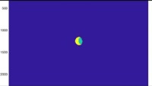
Engulfed
High-Diffusion
Colony

Slide 4

Random
Block
High-
Diffusion
Colony

Slide 5

Elongated
High-Diffusion
Colony

Slide 6
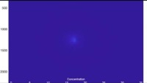
Nutrient A
Elongated
High-Diffusion
Colony

Slide 7
Nutrient B
Elongated
High-Diffusion
Colony

Slide 8
Elongated
High-Diffusion
Colony

Slide 9
Elongated
High-Diffusion
Colony

